Slide 1
Global PSP Project for Indian Embassies and Consulates
Quick Guide – Technical Setup for Capture Photo and Signature Screen (Active X, Exception Site List and Java Policy)

Slide 2
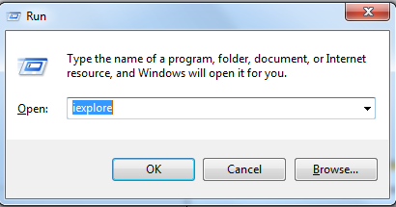
Active X Settings
Open Internet Explorer.
Click on Tools menu, and then click Internet Options.
On the Security tab, click the Custom level button.
Scroll down the Security Settings list until you see ActiveX controls and plug-ins.
Change the settings as described in the diagram (All values under “ActiveX controls and plug-ins” block must be in “Enabled” state).
Press Submit button.
P.T.O.

Slide 3
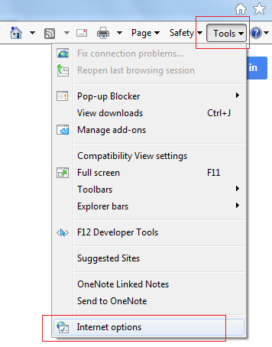
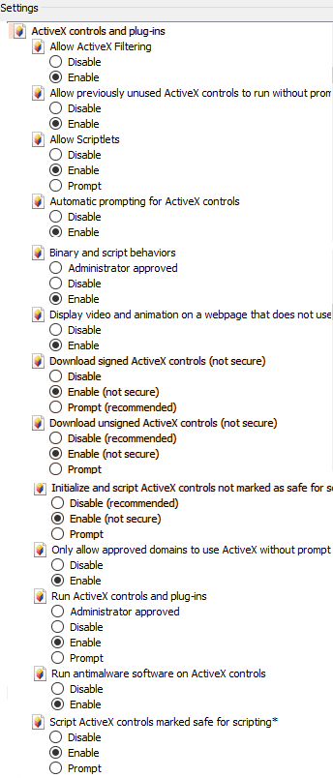

Slide 4

Exception Site List Settings
Open Control Panel.
Click the Java icon to launch the Java Control Panel
On the Security tab, click the Edit Site List button.
On the Exception Site List window click on Add button.
Enter Embassy/Consulate Users’ Login URL as applicable for your location, and press OK button:
https://embassy3.passportindia.gov.in/AppMissionUIProject/
(for Europe)
https://embassy4.passportindia.gov.in/AppMissionUIProject/
(for Americas)
https://embassy5.passportindia.gov.in/AppMissionUIProject/
(for Africa and Middle East)
https://embassy6.passportindia.gov.in/AppMissionUIProject/
(for Asia Pacific)
P.T.O.

Slide 5
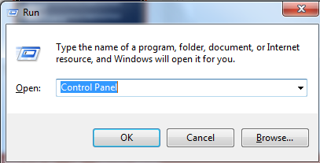
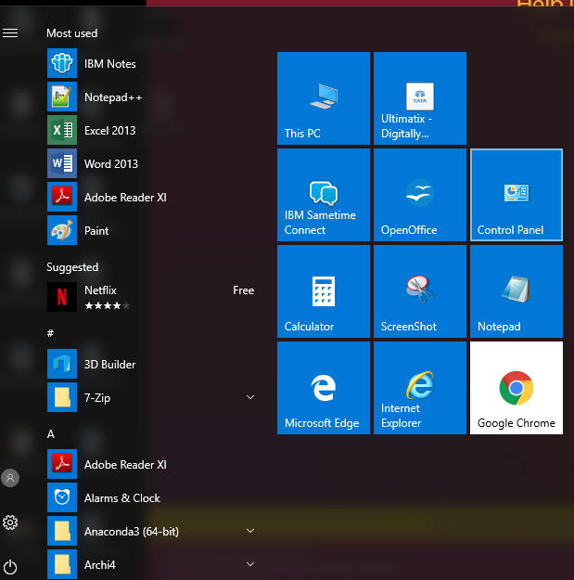

Slide 6
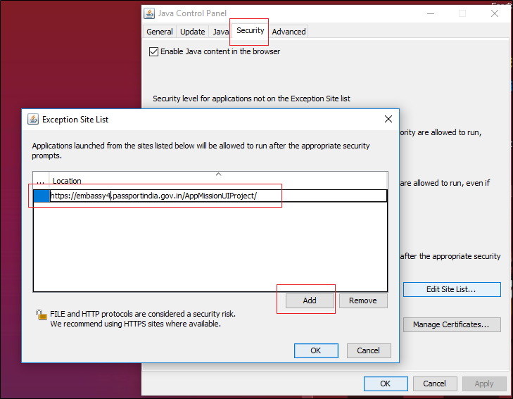

Slide 7
Java Policy Settings
Go to: <install_root>/java/jre/lib/security
Note: To Identify the java installation root path (<install_root>) – go to the Control Panel, Click Java to open the Java Control Panel, click the Java tab and copy the Path mentioned in the screen.
Open the java.policy file. Make sure the system user has the rights to change the content of this file.
Replace the policy file content with the following text:
grant {
permission java.security.AllPermission;
};
Save the file.
P.T.O.

Slide 8
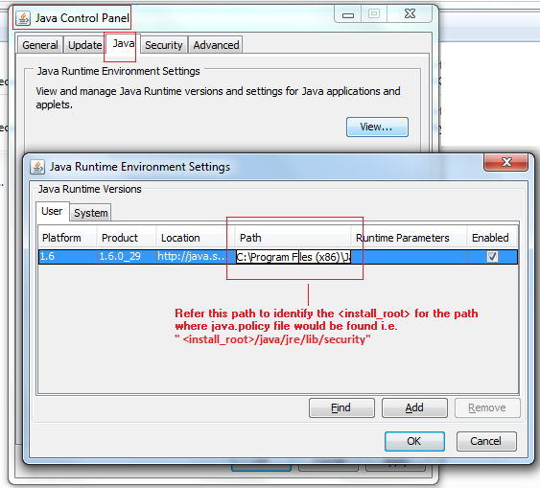
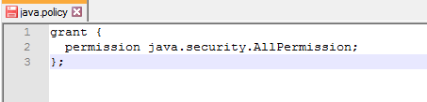

Slide 9
In case of additional information or clarification, please contact Global PSP Support Team at
Email : global.psp@tcs.com
Phone : +91-0120-672-9595/96
Mobile : +91-730-351-9595
Thank You

